Slide 1
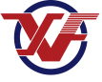
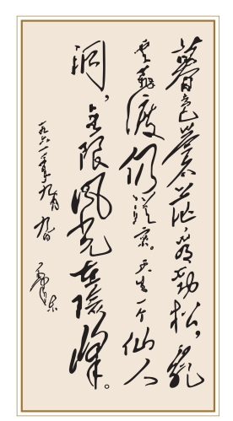
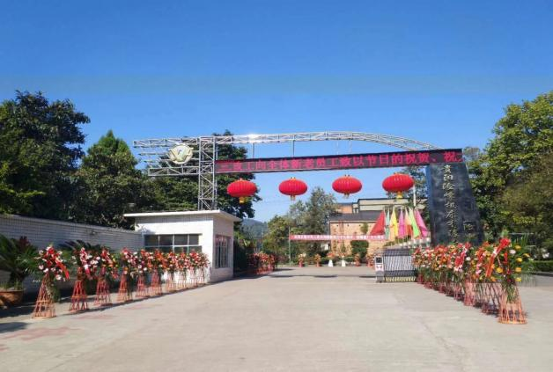
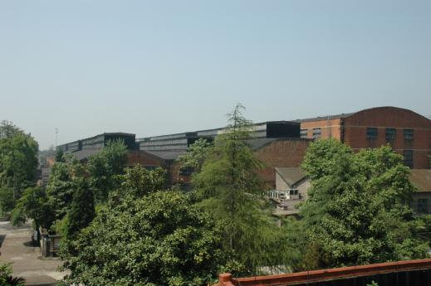
Guiyang Xianfeng Machine Tool Co., Ltd.

Slide 2
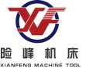
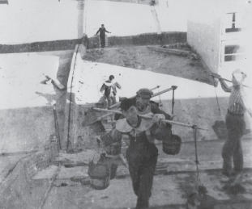
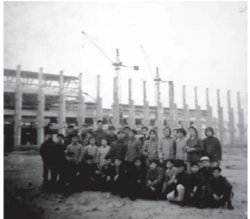
Guiyang Xianfeng Machine Tool Co., Ltd.
I. Company Overview
I) Development Process
1. Initial stage (1958-1964)
The company was founded in 1958, formerly known as Guizhou Heavy Forging Equipment Factory. As a key heavy industrial infrastructure project planned for the First Five-Year Plan period of China, it was built with the aid of the former Soviet Union. Following the deterioration of Sino-Soviet relations, the project faced suspension shortly after initiation. Ultimately, through active coordination by the Guizhou Provincial Government, the project was able to continue. Existing portions were merged or relocated, and through arduous efforts, gradually took shape.
Notes:
国家首都、世界城市、文化名城、宜居城市

Slide 3
Guiyang Xianfeng Machine Tool Co., Ltd.
I. Company Overview
However, due to that limitation of production condition data and technical capability at that time, there was no specific production at first. Essentially, whatever could be made was started, including self-made processing equipment. The first batch of products manufactured according to plan were air hammers. With the official launch of these products, it transformed the situation of machine tool manufacturing in Guizhou Province from non-existent to established.
Notes:
国家首都、世界城市、文化名城、宜居城市

Slide 4
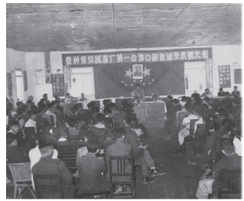
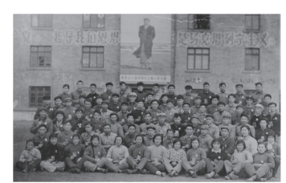
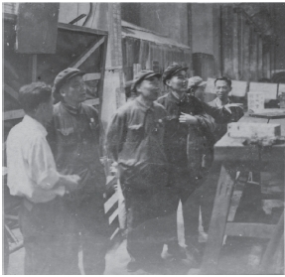
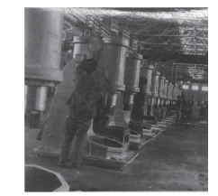
Guiyang Xianfeng Machine Tool Co., Ltd.
Notes:
国家首都、世界城市、文化名城、宜居城市

Slide 5
Guiyang Xianfeng Machine Tool Co., Ltd.
I. Company Overview
2. Shaping stage (1965~1990)
In 1965, during the third-line construction period, Wuxi Machine Tool Factory moved the personnel, equipment and technology of the centerless grinding machine production line, and merged with the enterprise to establish Xianfeng Machine Tool Factory. The enterprise formally moved on the track of benign development, and gradually took shape after various challenges and setbacks.
Notes:
国家首都、世界城市、文化名城、宜居城市

Slide 6
Guiyang Xianfeng Machine Tool Co., Ltd.
I. Company Overview
During this period, the enterprise has ushered in the most important and key historical development opportunity. With robust technical capabilities as support, the product range gradually expanded, leading to a steady development where forging and grinding machines emerged side by side. Several products became pioneers domestically, successfully filling gaps in the market. The first large-scale roll grinder, the first D42-630 rolling mill, and more were among these achievements. Notably, the roll forging machine and the centerless grinding machine became key export products, fostering friendly cooperation with developing countries and enhancing China's international reputation.
Notes:
国家首都、世界城市、文化名城、宜居城市

Slide 7
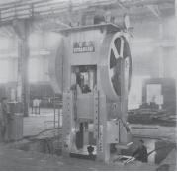
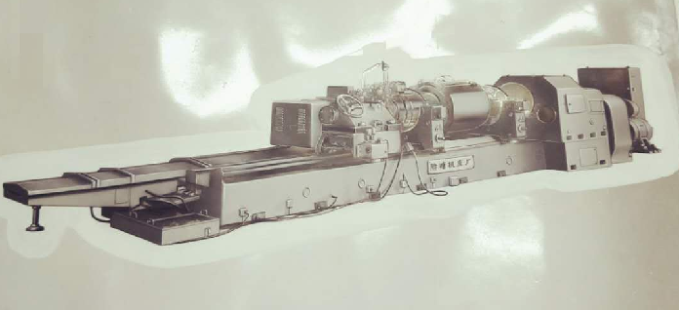
Guiyang Xianfeng Machine Tool Co., Ltd.
。
Notes:
国家首都、世界城市、文化名城、宜居城市

Slide 8
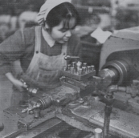
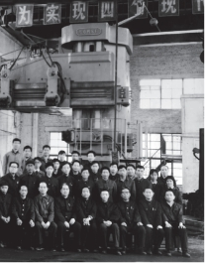
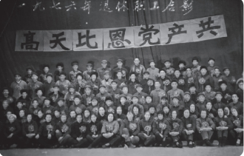
Guiyang Xianfeng Machine Tool Co., Ltd.
Notes:
国家首都、世界城市、文化名城、宜居城市

Slide 9
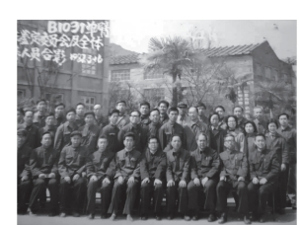
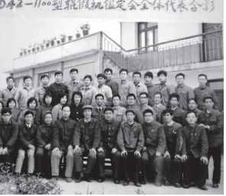
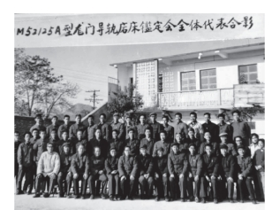
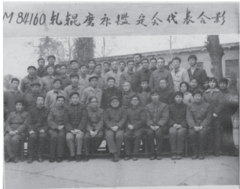
Guiyang Xianfeng Machine Tool Co., Ltd.
Notes:
国家首都、世界城市、文化名城、宜居城市

Slide 10
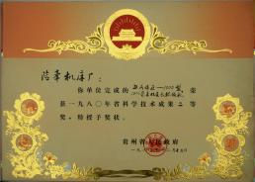
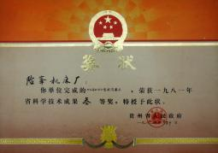
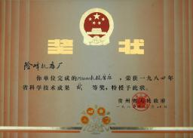
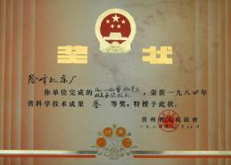
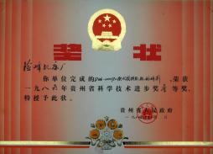
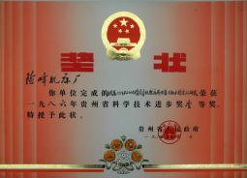
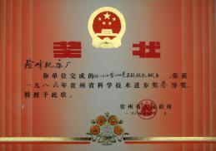
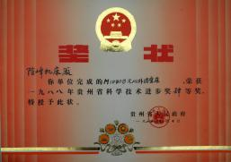
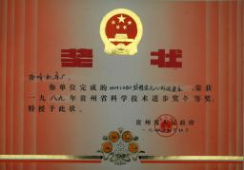
Guiyang Xianfeng Machine Tool Co., Ltd.
Notes:
国家首都、世界城市、文化名城、宜居城市

Slide 11
Guiyang Xianfeng Machine Tool Co., Ltd.
I. Company Overview
3. Mature stage of development (1991-2009)
In 1991, by incorporating advanced roll grinder manufacturing technology and design concepts from the foreign company WaldrichSiegen, the company independently developed the first domestically-produced MK84125 CNC roll grinder. This achievement not only filled a gap in the domestic market but also earned the company the honor of National Science and Technology Progress Second Prize. This marked the beginning of a new stage of maturity and success for the company.
。
Notes:
国家首都、世界城市、文化名城、宜居城市

Slide 12
Guiyang Xianfeng Machine Tool Co., Ltd.
I. Company Overview
During the period, the company continuously improved the construction of management system according to the requirements of modern enterprise development, and successively established ISO9001 total quality management system and ISO10012 measurement management system. At the same time, it attached importance to the leading role of science and technology as the first productive force, and being among the first batch to achieve certification of national enterprise technology center. Encouraging technological innovation to drive sustained development, it has become the drafting and revising entity for industry standards in domestic roll grinder and centerless grinding machine. Its CNC grinding machine products have been awarded the title of China Top Brand. Riding the wave of extraordinary growth in the domestic metallurgical rolling industry, the company entered a golden period of rapid expansion. Through mergers and acquisitions of multiple enterprises such as Huaxi Brick and Tile Factory, Qianguang Aluminum Products Factory, and Guiyang Pressure Casting Factory, it established Guizhou Xianfeng Industrial Co., Ltd., becoming a benchmark enterprise in the machine tool industry with remarkable strength. Its products have long held a leading market share, successfully filling domestic gaps with a variety of specifications, thus saving significant foreign exchange resources for China and making indispensable contributions to the development of related industries.
Notes:
国家首都、世界城市、文化名城、宜居城市

Slide 13
Guiyang Xianfeng Machine Tool Co., Ltd.
Notes:
国家首都、世界城市、文化名城、宜居城市

Slide 14
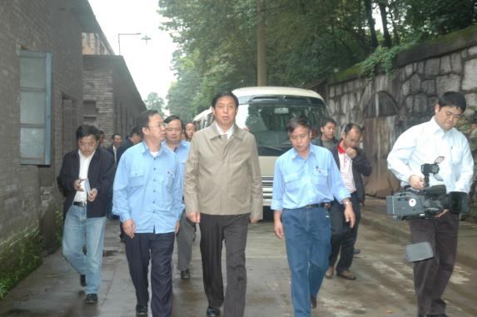
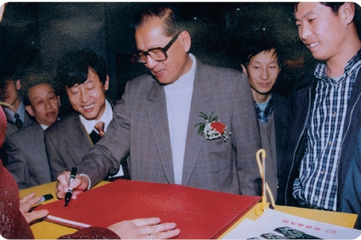
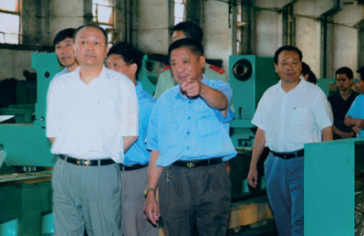
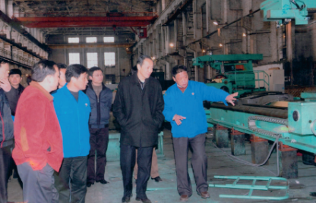
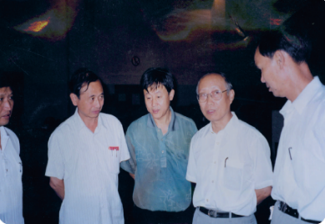
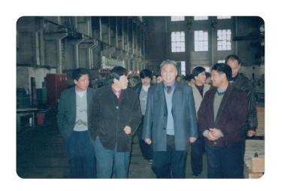
Guiyang Xianfeng Machine Tool Co., Ltd.
Notes:
国家首都、世界城市、文化名城、宜居城市

Slide 15
Guiyang Xianfeng Machine Tool Co., Ltd.
I. Company Overview
4. Adjustment stage (2010)
In 2009, in order to meet the needs of the restructuring of state-owned enterprises, the Company established Guiyang Xianfeng Machine Tool Co., Ltd. with the transfer of all assets of Xianfeng Machine Tool Factory. Since 2010, the Company invested RMB 570 million to start the construction of Xiaomeng Industrial Park of Guiyang Xianfeng Machine Tool Co., Ltd. to expand its capacity in other places. Due to the major misjudgment of the development trend of the industry, under the condition that the construction fund is not fully provided, the project construction was promoted by forced lending, which led a serious hidden danger for the subsequent development of the Company. During that period, the primary industries utilizing our products faced a severe overcapacity issue, leading to a sharp decline in demand. Under dual pressures, businesses encountered significant challenges in operations. Ultimately, with strong support from the Guiyang Municipal Party Committee and Government, the financial crisis brought about by the Xiaomeng project was successfully resolved. As the industry market gradually recovered in 2016, the company once again welcomed a new round of development opportunities.
Notes:
国家首都、世界城市、文化名城、宜居城市

Slide 16
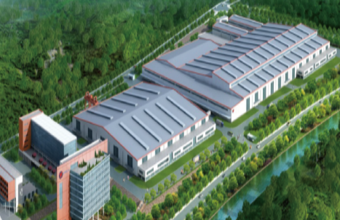
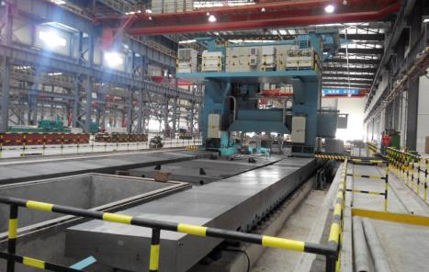
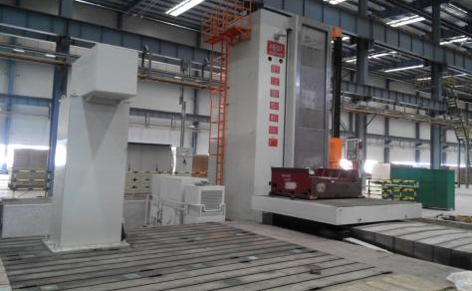
Guiyang Xianfeng Machine Tool Co., Ltd.
Notes:
国家首都、世界城市、文化名城、宜居城市

Slide 17
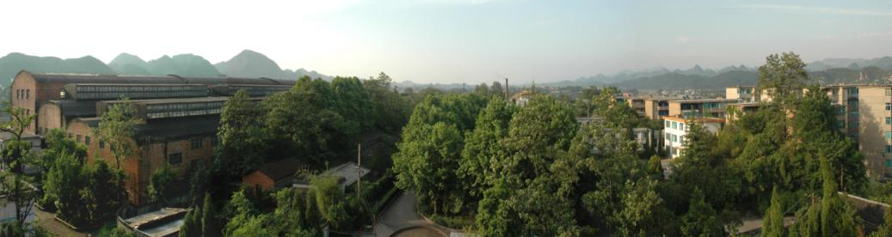
Guiyang Xianfeng Machine Tool Co., Ltd.
I. Company Overview
II) Basic Information
1. Business Operation: The Company is registered in Xiaohe National Economic and Technological Development Zone, Guiyang City, Guizhou Province, with the registered capital of RMB 100 million yuan and present assets of nearly RMB 700 million yuan. In 2018, the Company's main business income was RMB 170 million yuan, and the profit and tax was RMB 15 million yuan.
2. Staff: The company has more than 1000 employees, with 173 professional and technical talents, 271 high-skilled talents, including 104 with primary professional titles, 53 with intermediate professional titles, 16 with senior professional titles, 154 senior workers, 74 technicians and 43 senior technicians.
Notes:
国家首都、世界城市、文化名城、宜居城市

Slide 18
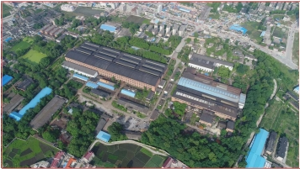
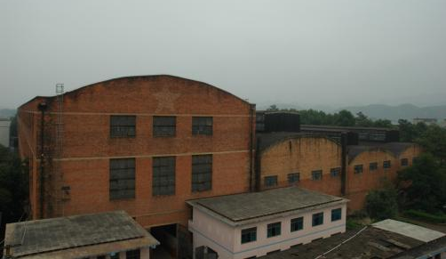
Guiyang Xianfeng Machine Tool Co., Ltd.
I. Company Overview
II) Basic Information
3. Production capacity: Huishui production and manufacturing base of the company covers an area of 370 acres and a building area of 80,000 square meters. There are more than 1,000 sets of main production process equipment, including: Swiss CNC precision cylindrical grinding machine, Japan Toshiba CNC precision boring machine, 32x4m super-large double-frame CNC planomilling machine, CNC guide rail grinding machine, various specifications of CNC machining center, turning and milling boring machine, CNC worm mill, resin sand production line, dual-frequency laser interferometer, three-coordinate machine, and a number of advanced process equipment and complete supporting detection equipment, with the total assets of nearly RMB 700 million. It has the annual production capacity of more than 700 sets of various professional machine tools. With an annual production capacity exceeding 700 sets of various specialized machine tools, it possesses a comprehensive industrial system encompassing the entire manufacturing process of CNC machine tools, from research and development, raw casting, production processing, assembly, testing, to after-sales service.
Notes:
国家首都、世界城市、文化名城、宜居城市

Slide 19
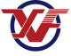
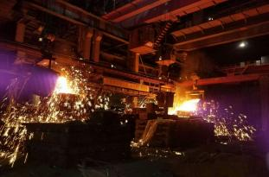
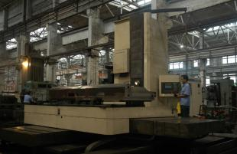
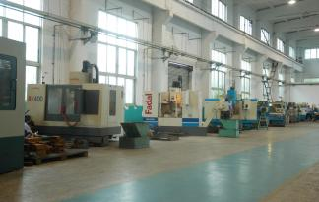
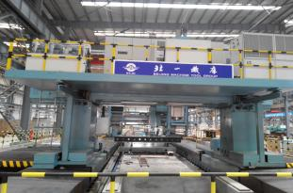
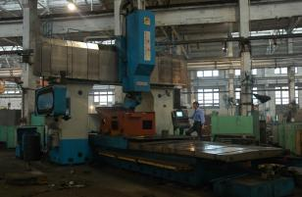
Guiyang Xianfeng Machine Tool Co., Ltd.
2. Main production capacity

Slide 20
Guiyang Xianfeng Machine Tool Co., Ltd.
I. Company Overview
II) Basic Information
3. R&D Capability
The company established the enterprise technology center in 1993, which was certified by the national enterprise technology center. It is now the provincial enterprise technology center of Guizhou Province, with more than 70 R&D personnel. The center comprises specialized research laboratories including grinding, electrical, hydraulic, process, and standards, as well as heavy-duty grinder and centerless grinding machine laboratories. The center has carried out Industry-University-Research in-depth cooperation with well-known domestic scientific research institutes for a long time, and has successively undertaken a number of major scientific and technological special research work of the Ministry of Machinery Industry, the Ministry of Science and Technology, the Ministry of Industry and Information Technology, as well as Guizhou Province and Guiyang City, and has successively developed 11 series of machine tool products with independent intellectual property rights and key core technologies in seven categories and different specifications. A number of technical achievements have become the first in China, filling the domestic gap, obtaining more than 40 national patents, and becoming the drafting and revision unit of the roll grinder industry standard. Over the years, the Center has established CAD/CAPP//PDM and other modern design and information management network systems through technical transformation, and has accumulated a batch of advanced and perfect testing equipment and experimental instruments such as dual-frequency laser interferometer, three-coordinate machine and so on. It has strong capacity in product design and development, experimental research and technical consulting services.

Slide 21
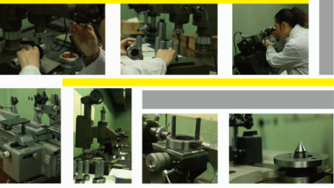
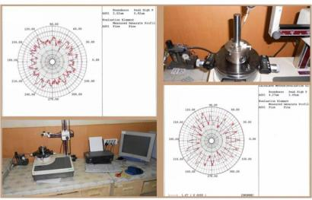
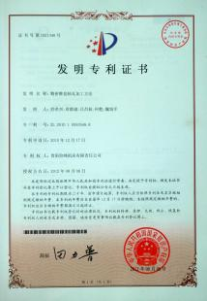





Guiyang Xianfeng Machine Tool Co., Ltd.
3. R&D Capability

Slide 22
Guiyang Xianfeng Machine Tool Co., Ltd.
I. Company Overview
II) Basic Information
4. Qualifications and Honors
Xianfeng Machine Tool has always adhered to a path led by technological innovation, guided by market demand, supported by quality assurance, striving for progress, and consistently solidifying its leading position in the industry. In 1995, it obtained ISO9001 Quality Management System certification, followed by ISO10012 Measurement Management System certification in 2007. In the same year, its "Xianfeng" brand CNC grinder was honored with the title of China Top Brand. The development of new products has repeatedly filled domestic gaps, achieving a series of significant technological breakthroughs. Among them, the CNC roll grinder has won numerous awards, including the National Scientific and Technological Progress Award, the former Ministry of Machinery Industry's Technological Progress Second Prize, as well as over a hundred awards for technological progress and outstanding new products from Guizhou Province and Guiyang City. Presently, it holds the title of a high-tech enterprise in Guizhou Province.

Slide 23





Guiyang Xianfeng Machine Tool Co., Ltd.
4. Qualifications and Honors

Slide 24









Guiyang Xianfeng Machine Tool Co., Ltd.
4. Qualifications and Honors
Notes:
国家首都、世界城市、文化名城、宜居城市

Slide 25
Guiyang Xianfeng Machine Tool Co., Ltd.
I. Company Overview
II) Basic Information
5. Company Culture
Corporate Spirit:
Love the factory, devote to work, unite together, strive for progress
Corporate Mission:
Pursue excellence, serve the world
Quality Policy:
Specialization, high-end and innovation-driven to promote development, strict management to maintain reputation, crafting quality products to build renowned brand, customer satisfaction as ultimate target
Principles of Cadre Work:
Dare to take on responsibilities, emphasize unity, promote communication, prioritize coordination, enforce execution

Slide 26






Guiyang Xianfeng Machine Tool Co., Ltd.
II. Flagship Products
1. Roll grinder
In 1968, the company developed and manufactured the first domestic roll grinder in China, is a drafting and revision unit of the national standards for roll grinders. Since then, it has evolved to possess a comprehensive range of product designs and manufacturing capabilities, from conventional to CNC models. It has been honored with the Scientific and Technological Progress Second Prize by both the national government and the former Ministry of Machinery Industry. The majority of its product series are pioneering innovations domestically, successfully filling market gaps and establishing itself as one of the best domestic brands for replacing similar imported machine tools. Its products are exported to over twenty countries and regions across Europe, Asia, Africa, and the Americas, enjoying a outstanding reputation internationally and ranking among the world's leading manufacturers of roll grinders.

Slide 27




Guiyang Xianfeng Machine Tool Co., Ltd.
II. Flagship Products
2. Centerless grinding machine
Wuxi Machine Tool Factory started manufacturing in 1965. Through continuous R&D and upgrading based on three basic products of M1080, M1083 and XF-004, a complete industrial chain of high-end intelligent product design and large-scale batch manufacturing, including CNC series products, on-line production grinding unit and so on, has been formed. At the same time, the company is the centerless grinding machine industry standard revision unit.

Slide 28







Guiyang Xianfeng Machine Tool Co., Ltd.
II. Flagship Products
3. Additions
Including the design and manufacture of guide rail grinding machine, ring rolling machine, roll forging machine, wedge cross rolling and track welding line grinding machine.

Slide 29










Guiyang Xianfeng Machine Tool Co., Ltd.
III. Introduction to Performance of Flagship Products
At present, the company's flagship products include two main categories: roll grinder and centerless grinding machine. They are primarily used for grinding shaft components in industries such as metallurgy, papermaking, shipbuilding, nuclear power, roll manufacturing, automotive, bearings, household appliances, and military. Roll grinders contribute to nearly 80% of the company's total revenue, holding a domestic market share of around 40% and maintaining a leading position over long term. Key customers include: Baosteel, ANSTEEL, Ma Steel, Shagang, Northeast Light Alloy, Southwest Aluminum, Yanshan Iron and Steel, Chenming Paper, Nanjing High Accurate Marine and other leading enterprises.

Slide 30


Guiyang Xianfeng Machine Tool Co., Ltd.
III. Introduction to Performance of Flagship Products
1. Introduction of CNC roll grinder series functions
CNC roll grinder series are CNC grinder products designed and produced by ourselves based on more than 50 years of experience in roll grinder manufacturing and by introducing and absorbing advanced machine tool manufacturing technology from Germany. It is divided into Grinding wheel moving type and workpiece moving type in structural form, and has the characteristics of high efficiency, high precision and safe and reliable use. It adopts the current advanced SIEMENS digital control technology and mechanical transmission technology, and the comprehensive performance of the whole machine reaches the world advanced level.
Workpiece moving type roll grinder
Grinding wheel moving type roll grinder

Slide 31


Guiyang Xianfeng Machine Tool Co., Ltd.
III. Introduction to Performance of Flagship Products
The grinding machine adopts SIEMENS SINUMERIK distributed computer CNC system, built-in S7-300 programmable controller. The I/O contacts outside the machine tool are transmitted to the central control system through PROFIBUS industrial field bus. The special human-machine interface for the Xianfeng roll grinder independently developed by SINUMERIK Integrate Create MyHMI is adopted. It has a variety of special requirements suitable for the roll grinder, and a concise and clear operation screen. It can realize the automatic control of the grinding machine and the simulation display, curve programming, measurement accuracy display, printing and storage of the automatic grinding measurement process.

Slide 32



Guiyang Xianfeng Machine Tool Co., Ltd.
III. Introduction to Performance of Flagship Products
Each CNC axis of the grinder is equipped with SIEMENS digital control AC servo motor and S120 drive system. Because the AC servo motor and the AC spindle motor have the advantages of high precision, maintenance-free and strong environmental adaptability, the grinding machine can work reliably for a long time under the severe field environment conditions. The roller measuring system adopts the Germany HEIDENHAIN precise linear grating, which ensures the roller measuring precision of the grinding machine and the position control precision of the CNC system. It is equipped with special electronic hand wheel for manual adjustment of each servo axis, and the adjustment amount can be accurately displayed through screen coordinates.

Slide 33

Guiyang Xianfeng Machine Tool Co., Ltd.
III. Introduction to Performance of Flagship Products
The roll measuring system adopts the new linear grating produced by HEIDENHAIN in Germany, which ensures the roll measuring precision of the grinding machine and the position control precision of the CNC system.
Operation display adopts SIEMENS 15-inch color LCD OP015A, Chinese and English display, and the operation system adopts English WINDOWS7. The system is equipped with comprehensive alarm and diagnostic functions, along with abundant assistance and operational prompts.

Slide 34



Guiyang Xianfeng Machine Tool Co., Ltd.
III. Introduction to Performance of Flagship Products
The main bearing of grinder is made of INA, FAG or SKF.
The grinding frame, measuring frame and curve grinding servo axis all utilize precision ball screw transmission from Germany's BLIS.
The main hydraulic components (pumps and valves) adopt Bosch-Rexroth products from Germany.

Slide 35
Guiyang Xianfeng Machine Tool Co., Ltd.
III. Introduction to Performance of Flagship Products
2. Introduction of basic functions
Full-automatic dynamic balance of grinding wheel
Automatic compensation of grinding wheel wear
Constant linear speed grinding with grinding wheel
Constant current grinding of grinding wheel
Automatic and rapid approach of grinding wheel
Short-stroke grinding (adaptive grinding)
Full-automatic dressing of grinding wheel
Full-automatic closed-loop control grinding
Automatic protection and safety interlock of grinding wheel power-off
Fault alarm and automatic diagnosis, fault report and recording function
Carry out data communication (including hardware and software) and report output with grinding roll room management system (L3) and factory management system
Computer and control system are equipped with UPS power supply
Operation interface: Chinese (optional in both Chinese and English)
hydrostatic lubricating (thin oil or grease) bracket of supporting feet
Maximum noise level of grinding machine: ≤80d
The measurement system enables the detection of:
Roll profile detection
Roll Roundness detection
Eddy current flaw detection
System security protection:
Grinding wheel spindle lubricating oil temperature, flow or pressure, pollution protection function
Safety, fault interlocking and monitoring protection function of mechanical and electrical equipment

Slide 36
Guiyang Xianfeng Machine Tool Co., Ltd.
III. Introduction to Performance of Flagship Products
2. Introduction of basic functions
Basic grinding mode:
Manual control grinding: grinding is controlled by electronic hand wheel.
Program control automatic grinding: realize full-automatic control grinding.
Supporting mode: Top grinding or bottom grinding
The following processing can be accomplished:
Grinding the cylindrical roll surface;
Grinding a conical roll surface;
Grinding a convex or concave curved roll surface;
Grinding a CVC curve and a roll surface of any combination curve;
It has the functions of straight line and circular arc sectional chamfer grinding.

Slide 37

Guiyang Xianfeng Machine Tool Co., Ltd.
III. Introduction to Performance of Flagship Products
3. Introduction of main specifications
3.1. Workpiece moving type roll grinder
This machine is applicable to the grinding the slender working rolls, intermediate rolls, and backup rolls of multi-roll mills for steel strips, copper strips, aluminum foils, and other products. It has the characteristics of high precision and high surface quality. Grinding can be performed using either top grinding or bottom grinding methods, typically employing a single-point measuring system, with the option for dual-point measurement for special requirements. The main axes include: [continue with the list of main axes] .
U-axis-curve grinding (AC servo)
Z-axis-worktable longitudinal movement (AC servo)
X-axis-transverse feed of the grinder carriage (AC servo)
C-axis-workpiece drive (AC spindle servo)
C1 axis-grinding head spindle drive (AC spindle servo)
X1 axis-dual-point measurement (special order)

Slide 38

Guiyang Xianfeng Machine Tool Co., Ltd.
III. Introduction to Performance of Flagship Products
3. Introduction of main specifications
3.1. Workpiece moving type roll grinder
1) Description of typical structure:
Bed: the workpiece bed and the grinding wheel bed are designed as an integral bed, adopting the form of "V-flat" guide rail. The bed of the machine tool is cast with high-strength low-stress alloy cast iron, and is annealed twice to eliminate the internal stress and ensure the stable and reliable precision of the machine tool foundation.
Headstock: siemens AC servo motor is adopted to drive the spindle rotation through a reduction gearbox and a primary stage triangular belt reduction, enabling stepless speed regulation. The center is fitted with a 5#Morse taper top with a hard alloy insert.

Slide 39
Guiyang Xianfeng Machine Tool Co., Ltd.
III. Introduction to Performance of Flagship Products
3. Introduction of main specifications
3.1. Workpiece moving type roll grinder
Description of typical structure:
Tailstock: two-layer structure, adjustable horizontal precision, can move manually along the worktable, using gear, rack transmission. The expansion and contraction of tailstock sleeve is 100mm and driven by gear transmission screw rod. Equipped with top clamping force indicator and linear trimmer.
Center frame: utilizing two supporting feet with adjustable bearing ranges. The center frame can be moved along the worktable direction via gear rack, with both upper and lower supporting feet adjustable via screw rods, lubricated with drip oil lubrication. The material of supporting feet for the center frame adopts Babbitt alloy (ZChSnSb11-6).

Slide 40
Guiyang Xianfeng Machine Tool Co., Ltd.
III. Introduction to Performance of Flagship Products
3. Introduction of main specifications
3.1. Workpiece moving type roll grinder
Description of typical structure:
Grinding frame: divided into upper and lower layers, V-flat rectangular plastic hydrostatic guide rail is used for transverse feeding. The feeding of grinding frame is realized through an AC servo motor driving an imported ball screw via a gearbox imported from Stober Germany. It offers high feed sensitivity, good vibration resistance, and smooth operation. Micro-feed is controlled by an electronic handwheel, with a minimum feed amount of 1μm, and feed amount display.
Intermediate-high mechanism: it is installed in the lower shell of the grinding frame. employing a plunge-type mechanism. The grinding frame is divided into two layers. When grinding the curve roll, the upper layer of the grinding frame rotates slightly around the rotary axis relative to the lower layer to grind the curve and the intermediate-high roll. The motion is sensitive and the feeding precision is high. The intermediate-high mechanism drives the ball screw to rotate through the speed reduction of the worm and gear by the servo motor, so that the upper layer of the grinding frame deflects to realize the high-precision curve grinding.

Slide 41
Guiyang Xianfeng Machine Tool Co., Ltd.
III. Introduction to Performance of Flagship Products
3. Introduction of main specifications
3.1. Workpiece moving type roll grinder
Description of typical structure:
Grinding wheel spindle: according to the characteristics of different industries, it adopts pure hydrodynamic lubrication bearing or hydrostatic-hydrodynamic lubrication bearing structure respectively. Driven by Siemens AC spindle motor. The advanced structure design and fine process guarantee measures make the grinding head capable of coarse, fine and polishing grinding. The grinding wheel is fed continuously during grinding to compensate for wheel wear.
Measuring device: It is equipped with single-point measurement, measuring the side generatrix of the workpiece, rotation of the measuring rod achieved by a hydraulic motor, and the measuring head using a German Heidenhain short grating for measuring the roundness, coaxiality, and cylindrical contour of the rolls. It can compare the contour curve with the given curve, automatically generate compensation curves for compensation grinding.

Slide 42



Guiyang Xianfeng Machine Tool Co., Ltd.
III. Introduction to Performance of Flagship Products
3. Introduction of main specifications
3.1. Workpiece moving type roll grinder
Product Pictures:

Slide 43
Guiyang Xianfeng Machine Tool Co., Ltd.
III. Introduction to Performance of Flagship Products
3. Introduction of main specifications
3.1. Workpiece moving type roll grinder
Main Customers:
Sales List of Xianfeng Machine Tool Workpiece Mobile CNC Roll Grinder
Product Type | Diameter/Length | User Unit | Time of Sale
MK8420 | 200/2000 | Zhejiang Tianhe High-tech Metal Material Co., Ltd. | 2011.2
 | 200/2000 | Anhui Xinke New Materials Co., Ltd. | 2016.2
MK8440 | 400/2000 | Wuxi Precision Belt Factory | 2006.09
 | 400/3000 | Cold Rolling Plant of Kunming Iron and Steel Co., Ltd. | 2008.03
 | 400/3000(2) | Jiangyin Yongli New Packaging Material Co., Ltd. | 2011.04
 | 400/3000 | Ningbo Boway Alloy Plate and Strip Co., Ltd. | 2011.06
 | 400/3500 | Jiangsu Fengyuan Aluminum Industry Co., Ltd. | 2011.08
 | 400/3000 | Jurong Zhongsheng Plate and Strip Science and Technology Co., Ltd. | 2016.10
 | 400/3000 | Bazhou Tianli Metal Products Co., Ltd. | 2017.02
 | 400/3000 | Qingyuan Hongya Metal Rolling Co., Ltd. | 2017.3
 | 400/3000 | Bazhou Sangang Technology Co., Ltd. | 2018.6
 | 400/3500 | Tangshan Jingjin Cold Rolling Galvanizing Co., Ltd. | 2018.6
 | 400/4000 | Zhejiang Hongyao High-tech Copper Co., Ltd. | 2014.3
 | 400/4000 | Hunan SUNTOWN Technology Group Co., Ltd. | 2014.7
MK8440A | 400/3000 | Jiangsu Delong Nickel Ind. Co., Ltd. | 2015.10
 | 400/2000 | Inner Mongolia Chifeng Yuanlian Steel Co., Ltd | 2016.2
 | 400/3000 | Zhejiang Rongxin Strip Steel Co., Ltd. | 2017.10
MK8450 | 500/3000 | Nigeria | 2008.11
 | 500/3500 | Kmd Precise Copper Strip (Henan) Co., Ltd. | 2015.11

Slide 44
Guiyang Xianfeng Machine Tool Co., Ltd.
III. Introduction to Performance of Flagship Products
3. Introduction of main specifications
3.2 Grinding wheel moving type
The product is suitable for the surface grinding of working rolls and backup rolls of cold-rolled and hot-rolled plate belts in the metallurgical industry, drying cylinders and rubber rolls in the papermaking industry and cylindrical workpieces made of various materials in the roll-making industry, and has the characteristics of high precision, high efficiency and multiple functions. Dual-point measuring structure is adopted to measure roll shape, roundness, cylindricity, workpiece diameter, etc. It has special functions such as paired roll grinding, self-adaptive grinding, quantitative grinding, measuring while grinding, flaw detection, function soft landing, belt case grinding, turning, milling and polishing, remote diagnosis and so on. A complete CNC roll grinder has seven main control axes, namely:
Grinding wheel rotary spindle-----C1 axis;
Workpiece rotary spindle-----C axis;
Carriage movement-----Z-axis;
Grinding frame movement-----X-axis;
Minor movement of grinding head-----U axis;
Measurement frame movement-----X1 axis.
Tailstock End Center Frame Automatic Adjustment (Roll Alignment)---U1 Axis (Option)

Slide 45

Guiyang Xianfeng Machine Tool Co., Ltd.
III. Introduction to Performance of Flagship Products
3. Introduction of main specifications
3.2 Grinding wheel moving type

Slide 46


Guiyang Xianfeng Machine Tool Co., Ltd.
III. Introduction to Performance of
Flagship Products
3. Introduction of main specifications
3.2 Grinding wheel moving type

Slide 47
Guiyang Xianfeng Machine Tool Co., Ltd.
III. Introduction to Performance of Flagship Products
3. Introduction of main specifications
3.2 Grinding wheel moving type
Description of typical structure:
Bed: the workpiece bed is divided into the grinding wheel bed to avoid the influence of workpiece weight and rotary motion on grinding; meanwhile, the relative position accuracy of the two bed guide rails can be adjusted respectively."V-flat" guide rail combination is adopted, and the cross section is a rectangular and triangular structure. The guide precision is high, and the lathe bed has good rigidity.
The lathe bed is cast with high-strength low-stress alloy cast iron and has been annealing twice to eliminate internal stress, so the lathe bed has small deformation and good wear resistance.
Grinding wheel bed
Workpiece bed
Sink

Slide 48
Guiyang Xianfeng Machine Tool Co., Ltd.
III. Introduction to Performance of Flagship Products
3. Introduction of main specifications
3.2 Grinding wheel moving type
Description of typical structure:
Headstock: Siemens 1PH8 AC spindle motor is adopted to drive the workpiece after being driven and decelerated by three-stage V-belt, with stable operation and no vibration. The bearing at the key position of the headstock adopts SKF or FAG imported bearing, and the headstock face plate is provided with a self-aligning floating disc device for driving the workpiece to rotate stably.
Special selection: headstock primary stage belt transmission structure;
Special functions of large grinding machine: disc hydraulic axial expansion function; auxiliary starting device of headstock.

Slide 49
Guiyang Xianfeng Machine Tool Co., Ltd.
III. Introduction to Performance of Flagship Products
3. Introduction of main specifications
3.2 Grinding wheel moving type
Description of typical structure:
Carriage: manufactured from high-strength, low-stress alloy cast iron, undergoes two annealing processes to eliminate stress. Adopts a "V-flat" guide rail configuration with manually scraped plastic-bonded hydrostatic guide rails, ensuring minimal wear, strong contact rigidity, high load-bearing capacity, low-speed creep-free operation, excellent resistance to overturning, and stable grinding accuracy. The carriage movement is driven by a Siemens 1FT7 AC servo motor, with position measurement controlled by a photoelectric encoder.
Special function configuration: the carriage is driven by double reduction gearbox or ball screw; the carriage moves at high speed; hydraulic telescopic pedal, etc.

Slide 50
Guiyang Xianfeng Machine Tool Co., Ltd.
III. Introduction to Performance of Flagship Products
3. Introduction of main specifications
3.2 Grinding wheel moving type
Description of typical structure:
Grinding frame: the transverse feed guide rail adopts "V-flat" combined plastic hydrostatic guide rail, manual scraping, good anti-vibration and anti-subversion performance. It adopts SIEMENS AC servo motor, low back clearance planetary reducer imported from Germany and precision ball screw transmission, realizing stepless speed regulation of transverse feed of the grinding frame, with good feeding precision and high sensitivity. The feeding position ring of the grinding frame is controlled by the German HEIDENHAIN linear grating, with accurate position and full closed-loop control. The feeding precision ≤0.001mm, and the maximum end feed amount is 0.05-0.09mm.

Slide 51
Guiyang Xianfeng Machine Tool Co., Ltd.
III. Introduction to Performance of Flagship Products
3. Introduction of main specifications
3.2 Grinding wheel moving type
Description of typical structure:
Grinding wheel spindle: It is composed of eccentric sleeve, spindle, hydrostatic regulator, unloading belt pulley, grinding wheel chuck disc, dynamic balance instrument, etc. Utilizing an integral hydrostatic-hydrodynamic bearing structure, offering high rotational precision, load-bearing capacity, and vibration resistance, meeting the requirements for rough grinding, precision grinding, and polishing. The grinding wheel spindle system are installed in a high-rigidity eccentric sleeve, which is supported by a hydrostatic chamber at the front end of the grinder housing. It is driven by a Siemens 1PH8/S120 AC spindle motor via a narrow V-belt (OPET) for continuous rotation. The grinding wheel spindle is equipped with an automatic balancing device.

Slide 52
Guiyang Xianfeng Machine Tool Co., Ltd.
III. Introduction to Performance of Flagship Products
3. Introduction of main specifications
3.2. Grinding wheel moving type roll grinder
Description of typical structure:
Curve grinding mechanism: installed inside the grinding frame, adopting high-precision rotary hydrostatic eccentric sleeve structure. The rotation of eccentric sleeve is driven by German Siemens AC servo motor through German ATLANTA speed reducer to rotate the precision ball screw installed vertically, the nut is driven to move up and down along the ball screw, and the swing rod is driven to drive the eccentric sleeve to rotate at a small angle, so that the grinding wheel can approach or retreat from the workpiece, and the grinding wheel is linked with the Z-axis to realize arbitrary curve grinding, up to the 12th power, with a maximum grinding depth of 1.5mm (on the radius). The swing rod is provided with a hydraulic energy storage type power-off protection oil cylinder, which realizes that the grinding wheel automatically retreats by 1mm when the power is cut off, and plays a role of safety protection.

Slide 53
Guiyang Xianfeng Machine Tool Co., Ltd.
III. Introduction to Performance of Flagship Products
3. Introduction of main specifications
3.2. Grinding wheel moving type roll grinder
Description of typical structure:
Center frame: In order to adapt to different roll necks, each set of center frame is equipped with different specifications supporting feet to the actual dimensions of the workpiece, ensuring that the grinding requirements for various roll neck sizes are met. The positions of the horizontal and vertical support blocks are adjusted using screws and sliders separately, and a dedicated supporting feet gauge is utilized to adjust the position.
The supporting feet is cast with babbitt alloy, which has the characteristics of good wear resistance and small abrasion to the workpiece.
Special selection function: oil-gas lubrication mode of supporting feet to reduce the loss of lubricating oil; moving mode of center frame is electric;
The transverse direction (U1 axis) of the center frame at the end of the tailstock is automatically adjusted for a slight amount (adjustment ±1mm) to compensate the installation error of the roll.

Slide 54
Guiyang Xianfeng Machine Tool Co., Ltd.
III. Introduction to Performance of Flagship Products
3. Introduction of main specifications
3.2. Grinding wheel moving type roll grinder
Description of typical structure:
Soft landing function: in order to reduce the impact of the roller on the supporting feet babbit alloy surface during lifting, a set of hydraulic soft landing device is designed on the workpiece bed to support the workpiece to move up and down when the workpiece is loaded and unloaded.
Tailstock: the tailstock generally adopts two-layer structure, and the upper layer can be adjusted slightly relative to the lower layer. and the center sleeve is provided with a workpiece pressing force display device. The tailstock moves longitudinally along the workpiece bed to meet the grinding requirements of different workpiece lengths. The base and sleeve can be motorized adjusted (or manually adjusted). The grinding wheel dresser is arranged on the inner side surface of the upper layer of the tailstock and is used for dressing the grinding wheel by using a diamond dressing pen. A measuring datum plate is installed at the front end of the tailstock sleeve. in order to calibrate the measuring system. The tailstock and sleeve shall be locked manually.
Special selection function: hydraulic telescopic of tailstock sleeve.

Slide 55
Guiyang Xianfeng Machine Tool Co., Ltd.
III. Introduction to Performance of Flagship Products
3. Introduction of main specifications
3.2. Grinding wheel moving type roll grinder
Description of typical structure:
Roll measuring system: CP type dual-point structure is adopted, which is installed on the grinding frame and moves together with the grinding frame. It comprises a measuring ram and two measuring arms A and B. The measuring ram is driven by SIEMENS1FT7 AC servo motor through planetary reducer and ball screw to drive the measuring arm A to move along the linear rolling guide rail direction to adapt to the measuring requirements of rolls with different diameters; the measuring arm B is installed on the base of the measuring frame to move with the grinding frame. During measurement, the measuring arms A and B are respectively rotated by 90 degrees through the hydraulic oil cylinder and put down into the measuring position, and the measuring arms are retracted at other times. The roll measuring system is equipped with German HEIDENHAIN long grating and two MT12W short gratings (A and B probes), with a resolution of 0.0001mm. In the measurement, the long grating ruler is used for diameter measurement. And the roundness, cylindricity, roll shape and other parameters of the roll are measured by the short grating ruler. Data can be measured before and after grinding by two measuring arms. The grinding program is automatically controlled after the measurement data is synthesized by CNC, and the given curve, actual curve, error curve and compensation curve of the roll are displayed on the LCD screen. If necessary, the measurement results can be printed out in the form of table or graph.

Slide 56
Guiyang Xianfeng Machine Tool Co., Ltd.
III. Introduction to Performance of Flagship Products
3. Introduction of main specifications
3.2. Grinding wheel moving type roll grinder
Description of typical structure:
The main advantages of the measuring device are:
High precision
a) Germany HEIDENHAIN high resolution digital grating is adopted.
b) Correction of mechanical errors by special measuring system.
c) Repeated measurement accuracy error ≤0.005mm.
Automatic measurement
All measuring arm movements and measuring operations are completed automatically.
Measuring while grinding
Used for fixed-diameter and quantitative grinding. The measurement is completed by the outer measuring arm (measuring arm A) to improve the grinding efficiency and matching grinding accuracy.
High reliability
The measuring arm and the probe have no impact force, so that the reliable measurement result is ensured.
Multi-functional
Eccentricity measurement
Roundness measurement
Diameter measurement
Measuring during grinding
Grinding with Roll
Optimized grinding based on comparison of set value and actual value
Adjustment of roll installation error (software adjustment)
Taper Software Compensation (A-B)/2

Slide 57

Guiyang Xianfeng Machine Tool Co., Ltd.
III. Introduction to Performance of Flagship Products
3. Introduction of main specifications
3.2. Grinding wheel moving type roll grinder
Description of typical structure:
CP type dual-point measuring device

Slide 58

Guiyang Xianfeng Machine Tool Co., Ltd.
III. Introduction to Performance of Flagship Products
3. Introduction of main specifications
3.2. Grinding wheel moving type roll grinder
Description of typical structure:
Eddy current flaw detection: a flaw detection probe is installed on the measuring arm outside the machine tool to detect the cracks on the roll surface, which can be started at any position. The flaw detection process is 100% and covers the roll surface and is provided with a degaussing device. Additionally, independent flaw detection can be performed either after grinding completion or during the grinding process.
Elastic foundation: In order to avoid the impact of vibration around the grinder on grinding, this machine can be equipped with elastic foundation. Key elastic elements are manufactured with German technology.

Slide 59



Guiyang Xianfeng Machine Tool Co., Ltd.
III. Introduction to Performance of Flagship Products
3. Introduction of main specifications
3.2. Grinding wheel moving type roll grinder
Description of typical structure:

Slide 60
Guiyang Xianfeng Machine Tool Co., Ltd.
VII. Introduction to Performance of Flagship Products
3. Introduction of main specifications
3.2. Grinding wheel moving type roll grinder
Main Customers:(since 2016):
MK8463×50 | Guangdong Huaguan Steel Co., Ltd. | 2016.01
MK8463×50 | Hebei Zhaojian Metal Products Co., Ltd. 2 sets (1420 cold rolling) | 2016.04
MKZ84125×50 | Hebei Zhaojian Metal Products Co., Ltd. 1 set (1420 rolling) | 2016.04
MK8480×50 | Jurong Zhongsheng Plate and Strip Science and Technology Co., Ltd. | 2016.10
MK8440×30 | Jurong Zhongsheng Plate and Strip Science and Technology Co., Ltd. | 2016.10
MK8463×40 | Shandong Tangrong New Material Co., Ltd. | 2016.9
MK8440×30 | Bazhou Tianli Metal Products Co., Ltd. | 2017.02
MK8440×30 | Bazhou Tianli Metal Products Co., Ltd. | 2017.04
MK8480×40 | Bazhou Tianli Metal Products Co., Ltd. | 2017.04
MK8480×4000 | Hebei Shengbao Iron & Steel Group | 2017.01
MK8440×30 | Qingyuan Hongya Metal Rolling Co., Ltd. | 2017.3
MK84125×60 | Fujian Kaijing New Technology Material Co., Ltd. | 2017.3
MK84125×5000 | Taian Shengde Daye New Material Co., Ltd. | 2017.3
MK8463×40 | Shandong Dongye Metal Products Co., Ltd. | 2017.3
MK8480×50 | Shang Shing Steel Industrial Co., Ltd. | 2017.6
MK8440A×30 | Zhejiang Rongxin Strip Steel Co., Ltd. | 2017.10
MK8480×40 | Jiangmen Huajin Metal Product Co., Ltd. | 2018.3
MKZ8480×50 | Hebei Anfeng Iron&Steel Co., Ltd. 3 sets (Line 1450) | 2018.4
MKZ84125×50 | Hebei Anfeng Iron and Steel Co., Ltd. 1 set (Line 1450) | 2018.4
MK84100×40 | Tangshan Jinma Steel Group Co., Ltd. | 2018.5
MKZ84125×50 | Bazhou Sangang Technology Co., Ltd. (950 cold rolling) | 2018.6
MK8463×50 | Bazhou Sangang Technology Co., Ltd. | 2018.6
MK8440×40 | Bazhou Sangang Technology Co., Ltd. | 2018.6
MKZ84125×50 | Xinyu Iron & Steel Co., Ltd. | 2018.6
MK8463×50 | Xinyu Iron & Steel Co., Ltd. | 2018.6
MK8440×35 | Tangshan Jingjin Cold Rolling Galvanizing Co., Ltd. | 2018.6
Product type | Name of user unit | Time of sale
MK8463×5000 | Shandong Wantong Metal Technology Co., Ltd. | 2016.08
MK8480×6000 | Tianjin Zhongwang Aluminum Co., Ltd. | 2016.2
MKZD84100×4000 | Yunnan Haoxin Aluminum Foil Co., Ltd. | 2016.01
MK84160×6000 | Shandong Wantong Metal Technology Co., Ltd. | 2016.02
MK8463×5000 | Shandong Wantong Metal Technology Co., Ltd. | 2017.05
MK84160×7000 | Shanghai Huafon Aluminium Corporation | 2017.05
MK8463×5000 | Tongling Jinyu Aluminum-based New Materials Co., Ltd. | 2017.5
MK84160×5000 | Tongling Jinyu Aluminum-based New Materials Co., Ltd. | 2017.5
MK8463×6000 | Henan Zhongfu Industrial Co., Ltd. | 2017.12
MK8480×30 | Ningbo Jintian Copper (Group) Co., Ltd. | 2017.12
MK8463×50 | Shandong Hontron Aluminum Industry Holding Co., Ltd. | 2017.9
MK84125×50 | Inner Mongolia Liansheng New Energy Materials Co., Ltd. | 2018.3
MK8480×50 | Qingyuan Chujiang Copper Industry Co., Ltd. | 2018.4
MK84200×80 | Xinjiang Xiangsheng New Material Technology Co., Ltd. | 2018.4

Slide 61

Guiyang Xianfeng Machine Tool Co., Ltd.
III. Introduction to Performance of Flagship
Products
3. Introduction of main specifications
3.3 Light CNC roll grinder
Description of typical structure:
The products are suitable for various industries such as papermaking and roll manufacturing, providing precision grinding for drying cylinders, calender rolls, and both metallic and non-metallic workpieces. They are characterized by high precision, a wide grinding adaptability range, and multifunctional capabilities. To meet the grinding needs of large-sized workpieces, the headstocks, tailstocks, and centering devices can be adjusted along the grinding direction. Users can choose from a variety of functions including milling, polishing, seat grinding, jacking grinding, off-center grinding, CBN wheel grinding, and dust extraction. Typically, the grinding fluid is supplied through a dual water system.

Slide 62
Guiyang Xianfeng Machine Tool Co., Ltd.
III. Introduction to Performance of Flagship Products
3. Introduction of main specifications
3.3 Light CNC roll grinder
Main Customers:
MQK84160×12000 | China CEC Engineering Corporation | 2012.2
MQK84200×10000 | Xuchang Hongfeng Paper Equipment Co., Ltd. | 2012.02
MK84200×12000 | Liansheng Paper Industry (Longhai) Co., Ltd. | 2013.12
MQK84160×6000 | Hangzhou Huafeng Paper Co., Ltd. | 2015.9
MK84200×18000 | Zhanjiang Chenming Pulp & Paper Co. Ltd. | 2015.8
MQK84200×12000 | Zhejiang Longyou Xuguang Remanufacturing Technology Development Co., Ltd. | 2015.7
MQK84160×6000 | Zhejiang Huafeng Paper Technology Co., Ltd. | 2016.4
MQK84160×10000 | Hubei Wuhe Machinery Co., Ltd. | 2016.1
MK84200×12000 | Jiangxi Chenming Paper Co., Ltd. | 2016.11
MK84125×9000 | Fujian Jinjiang Jingyang Rubber Roller Manufacturing Co., Ltd. | 2016.03
MQK84200×12000 | Zibo Taiding Papermaking Machinery Co., Ltd. | 2016.11
MK84160×12000 | Liyang Jiangnan Dryer Manufacturing Co., Ltd. | 2016.12
MK8480×8000 | Changzhou Winos Flower Roller Co., Ltd. | 2016.11
MQK84200×12000 | Tengzhou Deyuan High-tech Roll Industry Co., Ltd. | 2016.11
MK84160×12000 | Shandong Jianghe Paper Co., Ltd. | 2017.03
MQK84200×12000 | Shandong Taiding | 2017.01
MK84125×5000 | Taian Shengde Daye New Material Co., Ltd. | 2017.3
MK8463×4000 | Shandong Dongye Metal Products Co., Ltd. | 2017.3
MQK84200×1400 | Tengzhou Lhua Mitex Rubber Roller Manufacturing Co., Ltd. | 2017.6
MQK84200×100 | Export to UAE | 2018.2
MQK84160×80 | Export to Indonesia | 2018.3
MQK84160×100 | WANG Suijun | 2018.3
Main Performance Table of Xianfeng Machine Tool Light Roll Grinder
Product type | Name of user unit | Time of sale
MQK84200×8000 | Guangdong Zhongshan United Hongxing Paper Co., Ltd. | 2000.09
MK84100×5000 | Zhejiang Minfeng Special Paper Co., Ltd. | 2001.01
MK84200×10000 | Fujian Nanping Paper Co., Ltd. | 2001.05
MQK84200×12000 | Guangdong Dongguan Nine Dragons Paper (Holdings) Limited | 2002.11
MK84125×10000 | Mudanjiang Hengfeng Paper Co., Ltd. | 2006.07
MQK84200×7000 | Hubei Jingshan Light Industry Machinery Co., Ltd. | 2006.05
MQK84200×12000 | Suzhou Lihua Mitex Rubber Roller Manufacturing Co., Ltd. | 2007.07
MQK84200×10000 | Ningxia Meili Paper Industry Co., Ltd. | 2007.12
MQK84160×7000 | Shanghai Junshan Surface Technology Engineering Co., Ltd. | 2009.06
MQK84200×12000 | Henan Jianghe Paper Co., Ltd. | 2010.06
MK84200×18000 | Shandong Chenming Paper Holdings Limited | 2011.03

Slide 63
Guiyang Xianfeng Machine Tool Co., Ltd.
III. Introduction to Performance of Flagship Products
3. Introduction of main specifications
3.4 Special CNC roll grinder for hot rolling production line
Description of typical structure:
The products are suitable for the grinding requirements of the working roll, the backup roll, the pinch roll and the like on the hot rolling production line of the steel industry or the like with or without a box, and has the characteristics of strong efficiency, high automation degree and multifunctional integration. It generally has the functions of hydraulic expansion of head and tail frame, soft landing, grinding of working roll with box, grinding of supporting roll seat box and rapid movement.
Special function configuration: B-axis follow-up grinding.

Slide 64

Guiyang Xianfeng Machine Tool Co., Ltd.
III. Introduction to Performance of Flagship Products
3. Introduction of main specifications
3.4 Special CNC roll grinder for hot rolling production line
Description of typical structure:
Description of grinding process with bearing box:
The grinding of the work rolls with bearing box for rolling mills F1-F7 and R2 is achieved by supporting the roll axis on specialized center frame. At the headstock end, the bearing box is directly supported and fixed by hydraulic supports, while at the tailstock end, the bearing box is rotated 90°using a gear or tailstock fork structure, and the bottom is supported by hydraulic support blocks. The top ends of the headstock and tailstock are extended to fix the axial position of the work rolls. Once the above installation steps are completed, the automatic grinding program can be initiated.
Function: Strengthen the automatic working capacity of the grinding machine, reduce the labor intensity, reduce the labor cost and improve the grinding efficiency.

Slide 65
Guiyang Xianfeng Machine Tool Co., Ltd.
III. Introduction to Performance of Flagship Products
3. Introduction of main specifications
3.4 Special CNC roll grinder for hot rolling production line
Description of typical structure:
Description of seat box grinding process:
The function refers to the use of special tools, independent oil supply and return system and other special parts to meet the requirements of F1-F7 backup roll, R2 backup roll, R1 working roll and other supporting grinding directly depending on the bearing seat. The installation axis of the roll is corrected through U1 axis, and the manual oil cylinder is used for jacking; The top ends of the headstock and tailstock are extended to fix the axial position of the work rolls. Once the above installation steps are completed, the automatic grinding program can be initiated.
Function: Strengthen the automatic working capacity of the grinding machine, reduce the labor intensity, reduce the labor and maintenance cost, and improve the grinding efficiency.

Slide 66
Guiyang Xianfeng Machine Tool Co., Ltd.
III. Introduction to Performance of Flagship Products
3. Introduction of main specifications
3.4 Special CNC roll grinder for hot rolling production
Line Main Customers:
MK84160×70 | 1 | Minmetals Yingkou Medium Plate Co., ltd. | Hot rolled 2700 | 2008
MK84160×90 | 1 | Handan Iron and Steel Co., Ltd. | Hot rolled 3500 | 2009
MK84160×65 | 1 | Northeast Light Alloy Co., Ltd. | Hot rolled 4100 | 2011
MK84160×60 | 1 | Ningxia Jinning Juke New Materials Co., Ltd. | Hot rolled 2700 | 2011
MK84200×80 | 1 | Linfen Iron&Steel Co., Ltd. of TISCO Group | Hot rolled 3400 | 2005
MK84200×80 | 1 | Hebei Puyang Iron and Steel Co., Ltd. | Hot rolled 3500 | 2006
MK84200×80 | 1 | Hebei Jingye Group | Hot rolled 3500 | 2005
MK84200×90 | 1 | Northeast Light Alloy Co., Ltd. | Hot rolled 4100 | 2005
MK84200×90 | 1 | Jiangyin Changda Steel Co., Ltd. | Hot rolled 3500 | 2009
MK84200×90 | 1 | Zhongpu (Handan) Iron and Steel Co., Ltd. | Hot rolled 3500 | 2009
MK84200×90 | 1 | Pingshan County Jingye Plate Co., Ltd. | Hot rolled 1700 | 2009
MK84220×100 | 1 | Chongqing Iron and Steel Co., Ltd.(2) | Hot rolled 4100 | 2008
MK84250×120 | 1 | Nanyang Hanye Special Steel Co., Ltd. | Hot rolled 3800 | 2009
MK84200×90 | 1 | Shagang medium-thick plate | Hot rolled 3500 | 2016
MK84160×60 | 1 | Benxi Beiying Iron & Steel (Group) Co., Ltd. | Hot rolled 1780 | 2008
MKD84125×60 | 1
MKD84125×60 | 1 |  |  | 2010
MKD84100×60 | 2 | Xinyu Iron & Steel Co., Ltd. | Hot rolled 1580 | 2009
MK84160×60 | 1
MKZ84160×65 | 2 | Anhui Maanshan Iron&Steel Co., Ltd. | Hot rolled 1580 | 2014
MKZD84125×60 | 1
MK84160×65 | 2 | Tangshan Yanshan Iron&Steel Co., Ltd. | Hot rolled 1580 | 2016
MK84160×65 | 2
MK84160×65 | 2 | Hebei Anfeng Iron&Steel Co., Ltd. | Hot rolled 1780 | 2017
MKD84125×60 | 4
MKD84125×60 | 2 | Wu'an Yuhua Iron&Steel Co., Ltd. | Hot rolled 1450 | 2018
MK84160×60 | 1
Performance of Special CNC Roll Grinder for 1450 Hot Rolling Production Line of Xianfeng Machine Tool
Equipment model | Quantity | Using unit | Production line specifications | Time of putting into use
MK84100x50 | 1 | Shandong Taishan Steel (Group) Co., Ltd. | Hot rolled 1450 | 2005
MK84100x60 | 5 | Shandong Taishan Steel (Group) Co., Ltd. | Hot rolled 1580 | 2007
MK84100x50 | 1 | Sichuan Southwest Stainless Steel Co., Ltd. | Hot rolled 1450 | 2008
MK84100x50 | 1 | SinoSteel MECC (Export to Turkey) | Hot rolled 1450 | 2009
MK84125x60 | 1 | Shandong Taishan Steel (Group) Co., Ltd. | Hot rolled 1580 | 2007
MK84125x60 | 1 | Hebei Jingye Medium-Plate Co., Ltd. | Hot rolled 1580 | 2008
MK84160x60 | 1 | Shandong Taishan Steel (Group) Co., Ltd. | Hot rolled 1580 | 2007
MK84160x65 | 1 | Shandong Taishan Steel (Group) Co., Ltd. | Hot rolled 1580 | 2007
MK84160x60 | 1 | Sichuan Southwest Stainless Steel Co., Ltd. | Hot rolled 1580 | 2008
MK84160x60 | 1 | Xinyu Iron&Steel Group Co., Ltd. | Hot rolled 1580 | 2008

Slide 67








Guiyang Xianfeng Machine Tool Co., Ltd.
3.4 Special CNC roll grinder for hot rolling production line
Main products:
MK84125 CNC roll grinder
MKZD84125 full-automatic CNC roll grinder
MK84200 CNC roll grinder
MK84250 CNC roll grinder
MKZ84160×65 CNC universal roll grinder
Grinding roll room of 1580 hot rolling line of Yanshan Iron&Steel
Grinding roll room of 1580 hot rolling line of Yanshan Iron&Steel
Grinding roll room of 1450 hot rolling line of Yuhua Iron&Steel Co., Ltd.
Grinding roll room of 1780 hot rolling line of Anfeng Iron&Steel Co., Ltd.
Notes:
国家首都、世界城市、文化名城、宜居城市

Slide 68

Empower the "ship"_The First Large and Heavy-duty CNC Roll Grinder in China
Guiyang Xianfeng Machine Tool Co., Ltd.
In 2008, it independently developed and successfully manufactured the first set of MK84250 heavy-duty CNC roll grinder in China;
In December 2009, MK84250 heavy-duty CNC roll grinder won the first prize of Guizhou Excellent New Product and New Technology;
In October 2010, MK84250 heavy-duty CNC roll grinder won the third prize of China Machinery Industry Science and Technology Award; Nanjing High Accurate Marine Equipment Co., Ltd. ordered our XFK-160×12000 CNC cylindrical grinding machine for grinding large marine shaft in July 2008, and ordered one set of MK13125×8000 CNC cylindrical grinding machine in September 2011. Now the equipment is in good use.
In 2011, it independently developed and successfully manufactured MK84200×180 type turning, milling and grinding multifunctional composite CNC grinding machine, which was listed in the key project of the "12th Five-Year Development Plan for High-end Equipment Manufacturing Industry" and was supported by the Ministry of Industry and Information Technology of China

Slide 69


Empower the "ship"_The First Large and Heavy-duty CNC Roll Grinder in China
Guiyang Xianfeng Machine Tool Co., Ltd.
Application of MK84250 Heavy-duty NC Roll Grinder in Chongqing Iron and Steel Co., Ltd.

Slide 70


High-precision cylindrical grinding machine for "nuclear-powered submarine" transmission shaft
Guiyang Xianfeng Machine Tool Co., Ltd.
Production Site of Nanjing High Accurate Marine Equipment Co., Ltd.

Slide 71
Guiyang Xianfeng Machine Tool Co., Ltd.
III. Introduction to Performance of Flagship Products
3. Introduction of main specifications
3.5 Overseas Customers
13 | MK8463×40 |  | SinoSteel MECC | Export to Turkey (TOSYALI) | 2014.05
14 | MQK84200×60 |  | Guizhou Maikang | Belarus (RUP GAZETNOI) | 2015.04
15 | MK8463×40 | 1 | Harbin Haixun Science&Technology Trade Co., Ltd. | Nigerian Wempco Group (WSM900 Cold Rolling Mill) | 2014.08
16 | MK84125×50 | 1
17 | MJK84125×50 | 2 | Xianfeng Zhiyuan Import and Export Trade Co., Ltd. | Export to Germany | 2016.10
18 | MJK84125×60 | 1
19 | MQJK84160×60 | 1 | Shenyang Aobote Machinery Equipment Co., Ltd. | Export to Bangladesh | 2016.08
20 | MJK84125×50 | 1 | Tianjin Shitong Machinery Import and Export Co., Ltd. | Export to Germany (Optical Machine) | 2017.08
21 | MQK84200×100 | 1 | China Light-Industry International Engineering Co., Ltd. (CLIEC) | Export to UAE | 2018.02
22 | MQK84160×80 | 1 | Zibo Chenhang Paper Equipment Sales Co., Ltd. | Export to Indonesia | 2018.03
23 | MK8463×50 | 1 | Urumqi Tongyale International Trade Co., Ltd. | Export to Uzbekistan | 2018.07
24 | MK84125×50 | 1
25 | MK8463×50 | 1 | Beijing Zhengqi Power Technology Co., Ltd. | Export to Pakistan | 2018.11
26 | MK84125×50 | 1
27 | MK8440×40 | 2 | Beijing Zhengqi Power Technology Co., Ltd. | Export to Indonesia | 2019.03
28 | MK8480×40 | 1
29 | MKD84125×50 | 2
30 | MK84100×40 | 1
Guiyang Xianfeng Machine Tool Co., Ltd. roll grinder export performance table
Serial No. | Model | Number of sets | Import and export companies | Users | Time of sale
1 | MQ84160Bx60 | 1 | Beijing Metallurgical Equipment Research Design Institute Co., Ltd | Export to Myanmar | 2003.08
2 | MQ84160B/3x80 | 1 | China Chengda Engineering Company (Myanmar) | Myanmar Yeni Pulping and Papermaking | 2007.09
3 | MK84200x80 | 1 | China Machinery Engineering Corporation (CMEC) | Export to Vietnam | 2008.09
4 | MK8450x30 | 2 | Harbin Haixun Science&Technology Trade Co., Ltd. | Nigeria Wempco 900 Project Department | 2008.01
5 | M84100Bx40 | 1
6 | MK8463x40 | 2 | SinoSteel MECC | Turkey TOSLALI950 Hot Rolled Strip Project | 2009.03
7 | MK84100x40 | 1
8 | MK84125x60 | 1 | Xiamen Haihe Mechanical and Electrical Equipment Co., Ltd | Taiwell Aluminum Corporation (Taiwan) | 2009.08
9 | MK84160x80 | 1 | Tianjin Garment Import and Export Corporation | Thailand Weichengfa Medium Plate Factory | 2010.08
10 | MK84125x50 | 1 | Luoyang China Nonferrous Metals Processing Technology Co., Ltd | Det·AI Aluminum Plate and Strip Company in Ganja, Azerbaijan | 2011.12
11 | MK84125x50 | 1 | Guizhou Maikang | Exported to Thailand STARCORE Co., Ltd. | 2012.02
12 | MK84160x60 | 1 | China Aluminum International Engineering Co., Ltd.(CHALIECO) | Export to Venezuela (CVG-ALCASA) | 2013.05

Slide 72




Guiyang Xianfeng Machine Tool Co., Ltd.
3.5 Overseas Customers
1) MK84125x50 CNC roll grinder for aluminum plate and strip project exported to Det·AI Company in Ganja, Azerbaijan

Slide 73


Guiyang Xianfeng Machine Tool Co., Ltd.
3.5 Overseas Customers
2) Nigeria WSM900 cold-rolled color steel plate project
MK 84125x50 CNC roll grinder for Enugu cold rolled color steel project
M84100Bx40 roll grinder for Lagos cold rolled strip project

Slide 74




Guiyang Xianfeng Machine Tool Co., Ltd.
3.5 Overseas Customers
3) Belarus RUP GAZETNOI project MQK84200x60 light-duty CNC roll grinder

Slide 75



Guiyang Xianfeng Machine Tool Co., Ltd.
3.5 Overseas Customers
4) MK84125x50 CNC roll grinder for cold rolled strip project of Thailand STARCORE Co., Ltd.

Slide 76


Guiyang Xianfeng Machine Tool Co., Ltd.
3.5 Overseas Customers
5) MJK84160x60 roll grinder exported to Bangladesh paper project

Slide 77


Guiyang Xianfeng Machine Tool Co., Ltd.
3.5 Overseas Customers
6) WALDRICH. SIEGEN grinding machine reformation project in Indonesia

Slide 78
Guiyang Xianfeng Machine Tool Co., Ltd.
IV. Overall Planning for Technical Development
1. Fully understand the current situation of industry development
In recent years, the structural deceleration of China's economy has certain inevitability and complexity. During the five-year period of the 13th Five-Year Plan, the manufacturing industry will face the initial process of transformation, upgrading, innovation and development. In this process, there may be serious decline and huge challenges. Under the new normal of national economy, the vast majority of CNC machine tool manufacturing enterprises are bearing different degrees of downward pressure and severe market test. As steel, ships, automobiles, metallurgy, non-ferrous metals, papermaking, rubber, plastics, as well as printing and dyeing industries will face the transformation or rapid development, the requirements are increasingly improved, the product requirements gradually turn towards CNC, precision, intelligence, high efficiency, humanization and other directions. It is also inevitable for the Xianfeng company to stay out of the world. In recent years, there has been a noticeable gap in Xianfeng Company's autonomous innovation capability, resource utilization efficiency, industrial structure level, degree of informatization, and quality benefits. This presents a pressing and challenging task for the company's transformation, upgrading, and leapfrog development.

Slide 79
Guiyang Xianfeng Machine Tool Co., Ltd.
IV. Overall Planning for Technical Development
2. Guiding Principles for Scientific Research and Innovation
Aligned comprehensively with the "Made in China 2025" initiative, our guiding principles emphasize relying on technological progress to foster innovation and development, with a focus on enhancing quality and efficiency. We prioritize the deep integration of new technologies with existing products, advancing towards intelligent manufacturing as our primary direction. Our goal is to meet the demands of domestic industrialization and national major technical equipment by strengthening our scientific and technological foundation, enhancing the comprehensive development level of new products, improving the training system for scientific personnel, fostering a culture of innovation within Xianfeng, and realizing transformating Xianfeng branded products towards CNC, precision, intelligence, and efficiency. Our basic guiding principles are as follows:
1) Innovation-driven.
2) Quality first.
3) Structure optimization.
4) Talent-oriented.

Slide 80
Guiyang Xianfeng Machine Tool Co., Ltd.
IV. Overall Planning for Technical Development
3. Overall objective of product technology development
During the 13th Five-Year Plan period, after five years of continuous efforts, Xianfeng has responded to market demand by forming a complete product specification series. The overall technological level has entered the forefront internationally, with some products achieving original innovative breakthroughs, effectively meeting the needs of national key areas and national defense construction. This is specifically reflected in:
1) Roll grinder products reflect the differentiated development demand of the industry
Firstly, to meet the efficient, stable, green, and multifunctional composite heavy-duty CNC roll grinder needs of the hot rolled steel industry. Emphasis is placed on addressing the requirements of batch production in line with the construction of a fully integrated line. The typical characteristics of such grinding machine equipment include:
High speed: Increasing the grinding wheel linear speed from 45m/s to over 80 m/s, the carriage moving speed from 4 m/min to 10m/min, and the headstock speed reaching generally 100RPM, while maintaining stable operation at high speeds.

Slide 81
Guiyang Xianfeng Machine Tool Co., Ltd.
IV. Overall Planning for Technical Development
High efficiency: With strong grinding characteristics, there are clear indicators for hourly grinding removal, grinding time, etc., which pose significant challenges to key components such as the grinding wheel spindle and grinding stock in terms of load capacity and seismic resistance.
Auxiliary composite functions: In combination with the characteristics of hot rolling industry, a series of auxiliary function designs such as reducing tooling disassembly for box or seat box grinding, convenient workpiece hoisting, online measurement, remote diagnosis, etc., greatly reduce manual labor intensity and improve work efficiency. These auxiliary functions have features of stability, efficiency, speed, and simplicity.
Intelligentization: due to the lack of highly skilled personnel, the development of equipment is more inclined to realize concise operation through the application of complex, stable and intelligent control technology, namely the so-called one-key operation.
Stable operation: The long-term stable operation is based on the continuous improvement of the equipment from structural design to detail manufacturing. For example, the structural design with "over-positioning" and gapless is adopted, so as to realize long-term stable operation through multiple positioning and obtain high-precision and high-sensitivity transmission control, which is based on the accurate control of details.

Slide 82
Guiyang Xianfeng Machine Tool Co., Ltd.
IV. Overall Planning for Technical Development
Precision: At present, the performance requirements of hot rolling industry for grinding machine are not only reflected in high speed and high efficiency, but also higher requirements for precision grinding. It mainly refers to precise measurement, repeated positioning with small error, closed-loop control of CNC axes and highly coincident complex curve. Therefore, it is necessary to select the structural design of "over-positioning" and gapless.
Green: It is mainly reflected in the effective recycling and reduction of daily consumables such as equipment lubricating oil, grinding fluid, Babbitt alloy, etc., to realize the concept of creating value for customers.
Service: On the one hand, strengthen user-guided training operations and regular maintenance through remote diagnostic technology, on the other hand, also establish regional service networks in key areas and for key customers to improve the timeliness and effectiveness of services.
Secondly, focusing on the special, medium-sized roll grinders required for high precision and high macro-surface grinding quality in the cold rolling and foil rolling plate industries, typical features are demonstrated by the "three-no" grinding surface.
Thirdly, meeting the needs of industries such as papermaking and external processing for multifunctional composite roll grinders, with typical features including combined applications of functions such as turning, milling, polishing, and seat box grinding.

Slide 83
Guiyang Xianfeng Machine Tool Co., Ltd.
IV. Overall Planning for Technical Development
2) Centerless grinding machine reflects the characteristics of precision, high efficiency and intelligence.
As a staple product of the company, it has enjoyed a broad customer base due to its stability, durability, and strong adaptability. However, in the general-purpose, centerless grinding machine field, the lowering of market entry barriers has led to inevitable low-cost, homogeneous competition. Presently, the standalone value of such grinding machines produced by the company has approached manufacturing costs, with profit margins almost negligible. Nevertheless, production is maintained due to the potential for labor cost reduction through scaled mass production.
In recent years, driven by industrial transformation and development in traditional user markets such as automotive parts and bearings, the demand for component machining quality has continued to rise, as well as the rising labor costs. All these have imposed higher requirements on the precision grinding maintenance, efficiency, automation level, humanized operation, appearance quality, and safety of workhorse machines like centerless grinding machine.
Mainly reflected in the following aspects:

Slide 84
Guiyang Xianfeng Machine Tool Co., Ltd.
IV. Overall Planning for Technical Development
Precision: On the basis of improving the grinding precision of parts from micron level to nano level, it is required to realize high speed and high-efficiency batch grinding.
Speed: the linear speed of the grinding wheel is increased from 45M/S to more than 80M/S, and the rotating speed of the guide wheel is increased from 200 RPM to 400 RPM;
Operation accuracy: the repeated positioning accuracy of the CNC axes is improved from 0.003 to 0.001mm.
Operation: more concise and intuitive, fully reflect the humanized design.
Appearance: Emphasizes integrity, customization, and eco-friendliness.
Degree of automation: comprehensive CNC application, and a large number of automatic monitoring, automatic compensation, automatic measurement, intelligent identification, automatic transmission technology to reduce manual interference, improve grinding stability, realize multi-unit linked operations to reduce labor productivity and labor costs.
Safety: Adopt protective cover to isolate the processing area and operation area, and add measures such as safety detection and interlocking protection to reduce the probability of failure.
Multi-material grinding adaptability.

Slide 85
Guiyang Xianfeng Machine Tool Co., Ltd.
IV. Key research topics to be implemented in the near future
1. Key technology application and industrialization of high-end intelligent grinding machine manufacturing
2. Development of remote operation and maintenance big data management and control cloud platform technology
3. Construction of digital factory
4. Research and development on unmanned grinding roll workshop management system

Slide 86
Guiyang Xianfeng Machine Tool Co., Ltd.
We warmly welcome the generous support of friends from all sectors, aiming for win-win cooperation and collaborative development, to jointly promote the smooth transformation and upgrading of China's equipment manufacturing industry!

Slide 87
Thank you!

